Slide 1


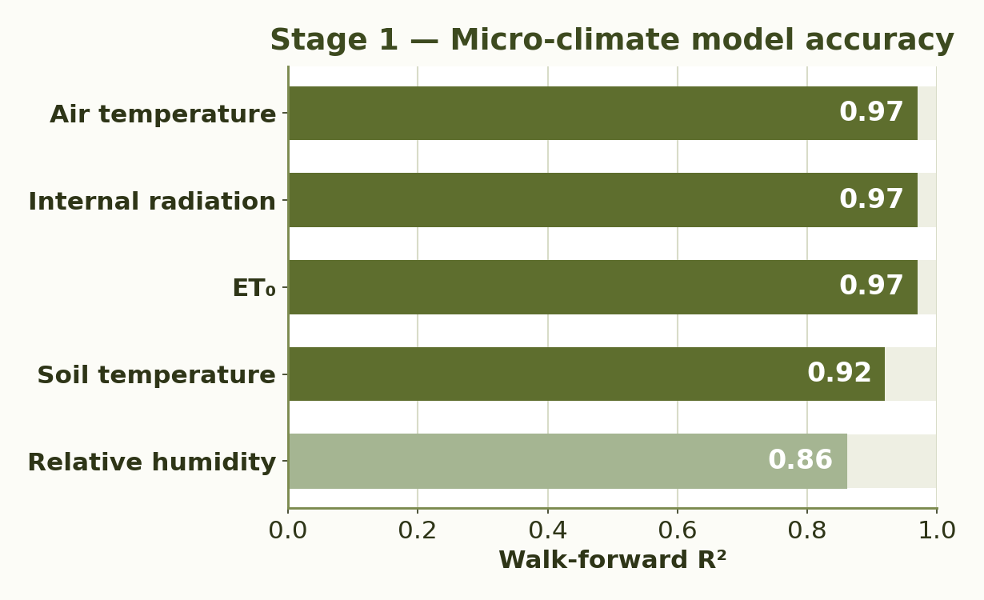
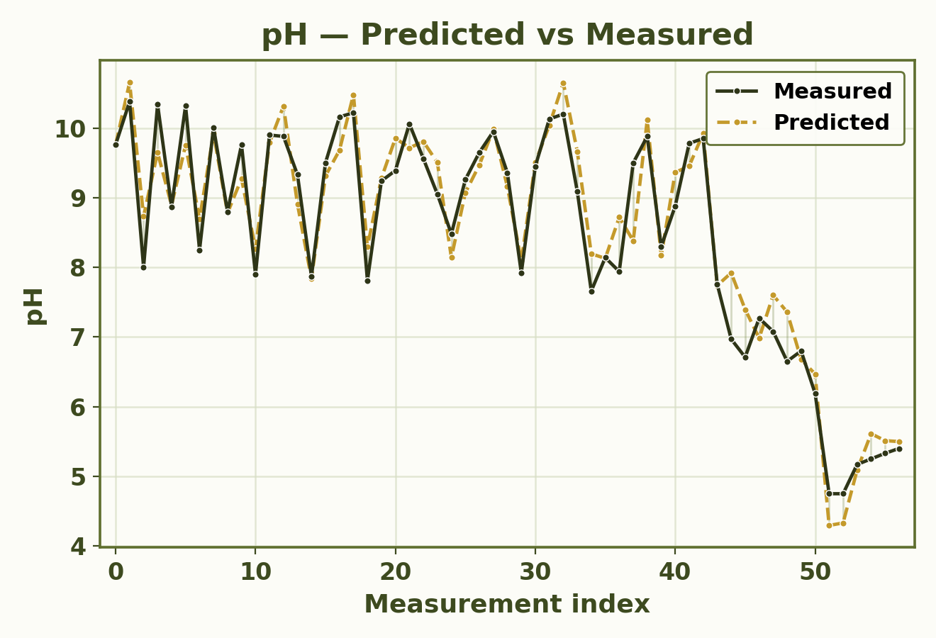
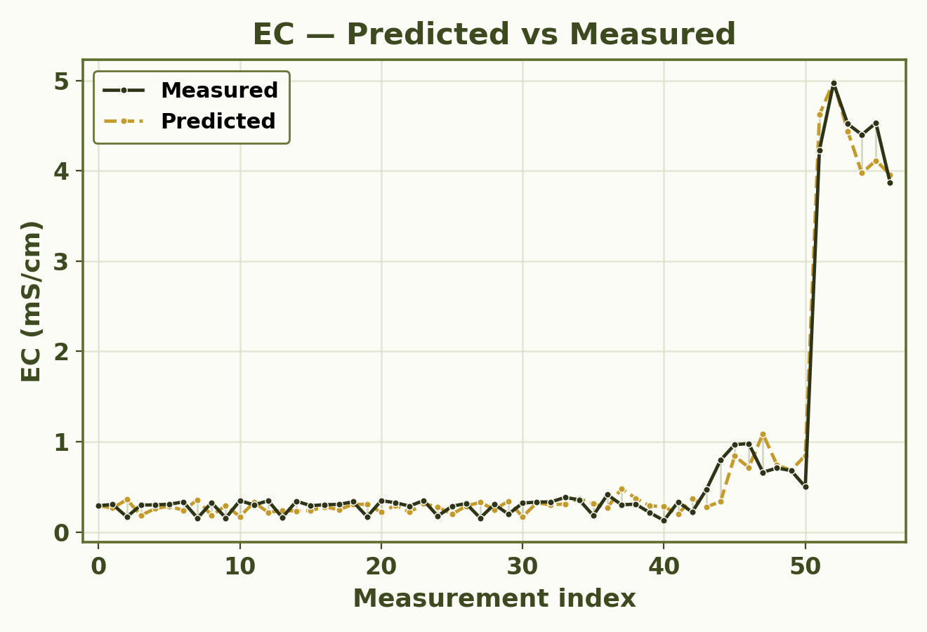
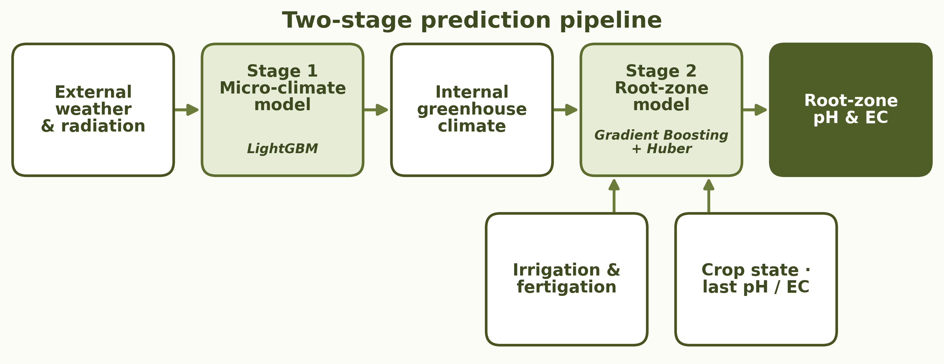
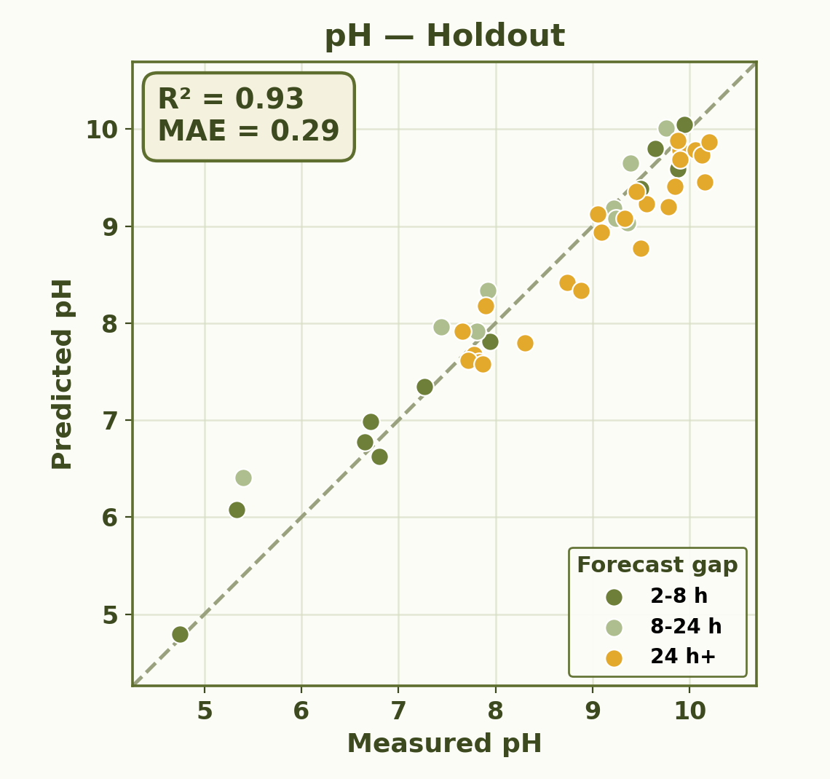
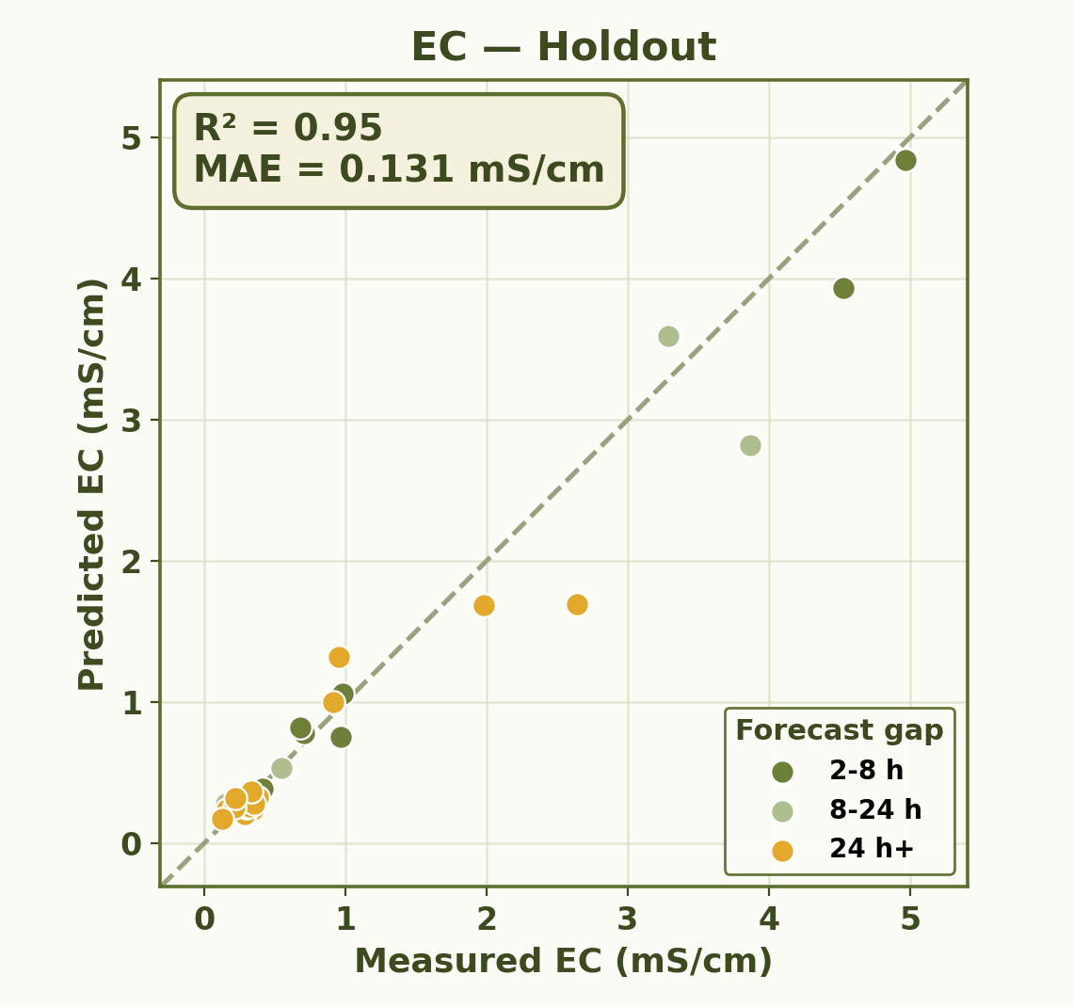
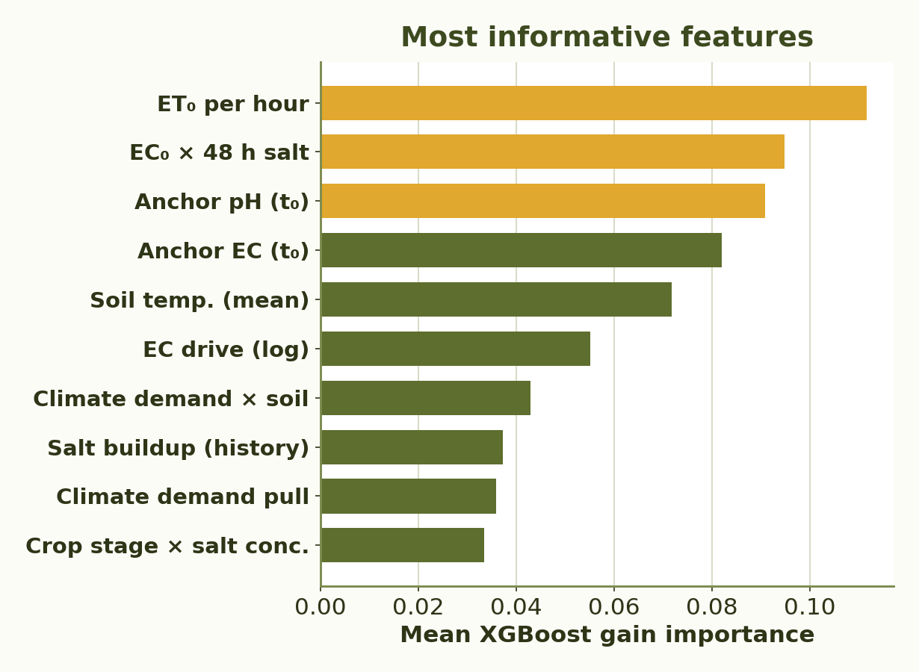
RUPPIN ACADEMIC CENTER · DEPARTMENT OF COMPUTER SCIENCE · AI & DATA SCIENCE SPECIALIZATION
Predictive Modeling of Root-Zone Variables Using Greenhouse Data
Students: Eden Eliyahu, Oren Chaushu
Supervisors: Dr. Avner Priel, Dr. Alaa Jamal
01
Motivation
06
Micro-Climate Model
▪ Root-zone pH governs nutrient availability, while EC reflects salinity and fertilizer load - both directly affect crop health, growth and yield. ▪ In soilless greenhouse systems, the root zone has low buffering capacity, so irrigation or fertigation errors can quickly affect plant conditions.
▪ Manual laboratory pH/EC samples are accurate, but sparse, slow and reactive, leaving long blind gaps between measurements.
▪ Continuous probes can provide dense data, but they may drift, require frequent calibration and represent only a single point in the root zone.
▪ Predicts internal greenhouse climate from external weather and radiation.
▪ Generates continuous climate inputs - temperature, RH, radiation, ET₀ and soil temperature - for the root-zone model.
02
Project Goal
▪ Build a machine-learning soft sensor that estimates future root-zone pH and EC between sparse manual laboratory samples. ▪ Predict the change from a known baseline measurement at t₀ to a future target time t₁ using climate, irrigation, fertigation, crop-state and previous pH/EC information.
▪ Provide reliable decision-support values that help growers detect pH or salinity drift earlier and maintain the root zone within an optimal operating range.
03
Data
07
Root-zone Model Results
16,682
10-min rows
109
pH / EC labels
20+
input features
Walk-forward validation shows that the model predicts future pH and EC from past observations while maintaining strong accuracy over time.
▪ Unified 10-minute master dataset · May 29 – Sep 21, 2025. ▪ External weather & solar radiation — open-field weather and radiation measurements. ▪ Greenhouse micro-climate — internal air temperature, relative humidity, radiation, ET₀ and soil temperature. ▪ Irrigation & fertigation — water volume, fertilizer, EC, acid dosing and event timing. ▪ Crop-state features — canopy cover, crop development and time-history variables. ▪ Manual laboratory pH & EC measurements.
0.33
pH MAE
0.93
pH R²
+62%
pH MAE gain
0.127
EC MAE
0.98
EC R²
+35%
EC MAE gain
04
Method
▪ Two-stage soft sensor - Stage 1 predicts greenhouse micro-climate from external weather; Stage 2 predicts root-zone pH & EC.
▪ Models the t₀→t₁ interval change rather than labelling every timestamp.
Skipped-interval holdout testing confirms that the model generalizes to unseen intervals that were removed from the training process.
05
Algorithms & Model Choice
Gradient Boosting
Performs well on tabular greenhouse data; captures nonlinear interactions between climate, irrigation, fertigation, crop state and previous pH/EC. Suited to the hybrid interpolation / extrapolation task.
Huber Regressor
Robust to outliers and the sharp changes caused by fertigation, acid injection or salinity shifts. A stable, complementary model that handles noisy and extreme target behavior.
08
Conclusions
▪ Acts as a soft sensor, estimating root-zone pH & EC between sparse manual lab samples.
▪ The hybrid two-stage approach improves accuracy over the last-measurement baseline (+62% pH, +35% EC).
▪ Designed for decision support - guiding irrigation & fertigation - not autonomous control.
09
Challenges & Limitations
▪ Only 109 manual pH/EC labels against 16,682 dense sensor records.
▪ No continuous ground-truth pH/EC between lab samples.
▪ Irregular sampling intervals complicate interval modelling.
▪ Higher uncertainty in rare or extreme fertigation / salinity cases.
▪ Limited generalization - data from a single season and one crop.
▪ More seasons, crops & greenhouse conditions needed for stronger validation.

